Slide 1


Slide 2
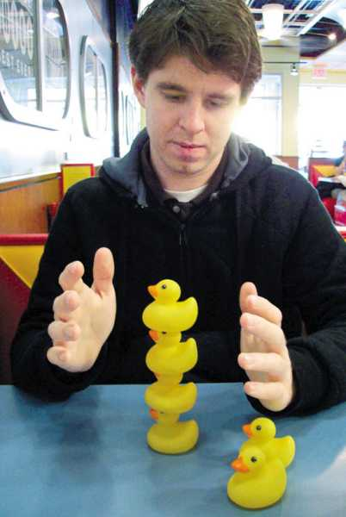
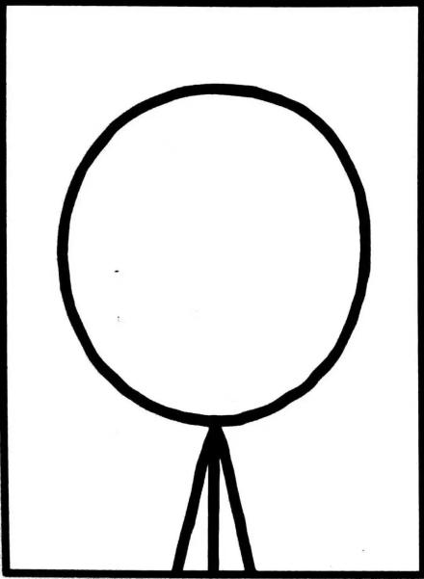
INFORMATION ABOUT THE AUTHOR…
Founder of xkcd
(a science comic website)
Degree in physics
Webcomic artist
Roboticist in NASA
Randall Munroe

Slide 3
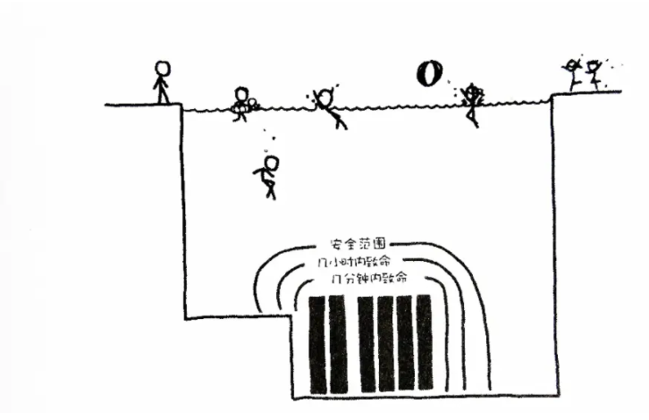
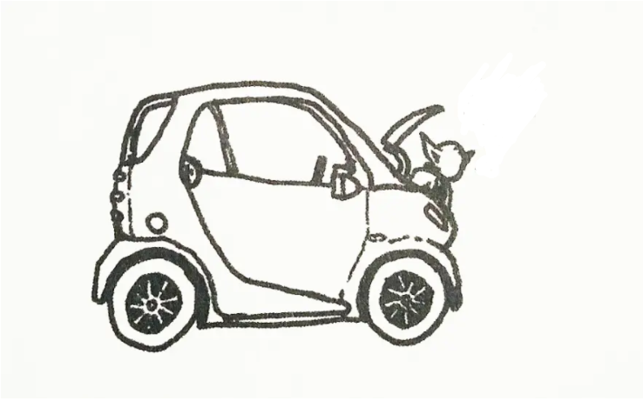
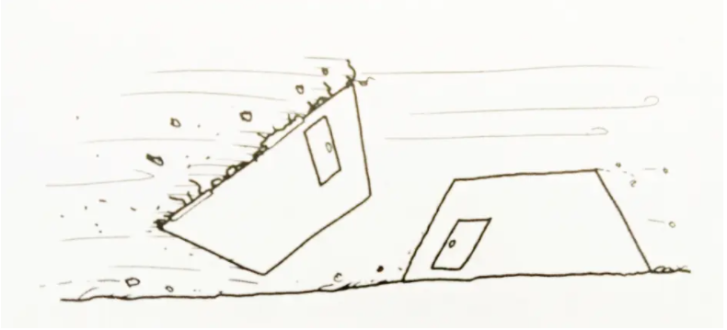
WHERE DID THE BOOK CAME FROM?
SERIOUS ANSWERS TO ABSURD QUESTIONS
How much power can Master Yoda produce?——19.2kW
Will I die if I dive into a spent fuel pool(乏燃料池)?
What if the earth stop spinning?

Slide 4
Q:Can I make a jetpack using the recoil force(后坐力) from a gun?

Slide 5
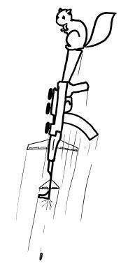
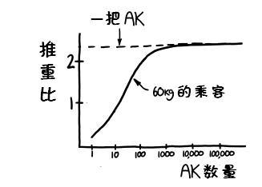
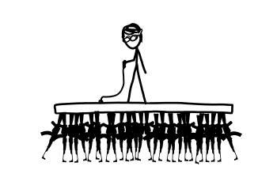
Subproblem : Can a gun push itself up?
AK-47: F=10bullets/sec x 8g x 715m/sec =57.2N > G

Slide 6
But the bullets have weight! =>
Best option:300guns x 250bullets

Slide 7
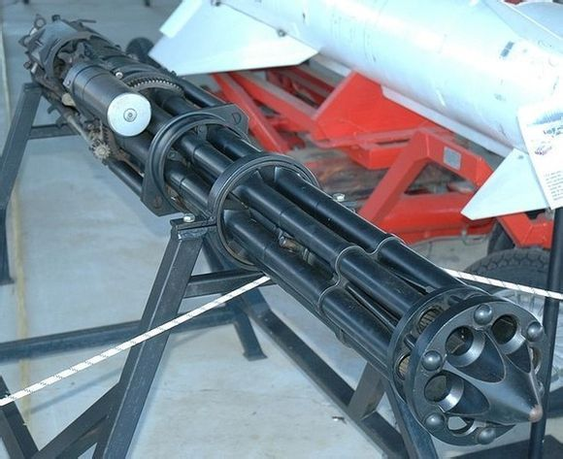
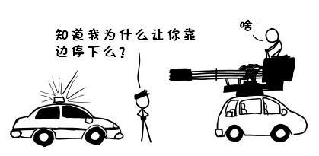
GSh-6-30 : thrust ratio(推重比)=40
has greater force
very light
You know why I stop you?
AK isn’t enough……
“I wonder how would you stop me later”

Slide 8
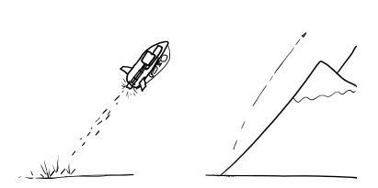
“With this gun we can fly over Himalayas!”

Slide 9
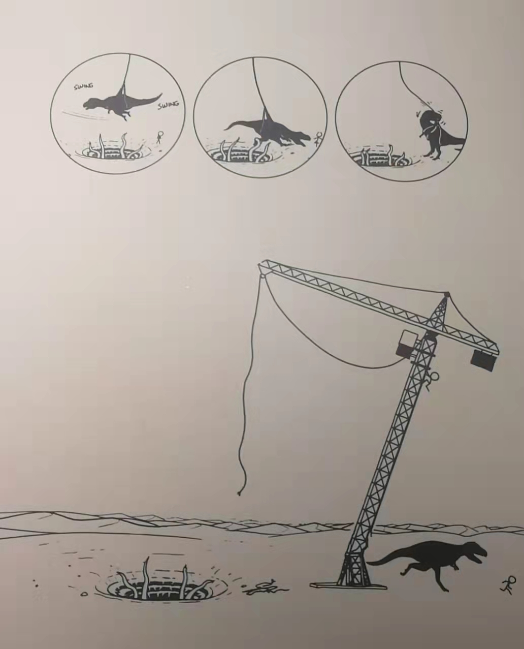
Ridiculous
How can we use our math,physics,chemistry…knowledge to solve a problem in reality
How to consider a problem from different ways
Science is fun

Slide 10
THANK YOU

